Slide 1
Chapter 3
Image Enhancement
in the Spatial Domain

Slide 2
Image Processing Techniques
Spatial Domain
Spatial Filtering
Intensity Transformation
Frequency Domain

Slide 3
Image Enhancement in the
Spatial Domain
The spatial domain:
The image plane
For a digital image is a Cartesian coordinate system of discrete rows and columns. At the intersection of each row and column is a pixel. Each pixel has a value, which we will call intensity.
The frequency domain :
A (2-dimensional) discrete Fourier transform of the spatial domain
We will discuss it in chapter 4.
Enhancement :
To “improve” the usefulness of an image by using some transformation on the image.
Often the improvement is to help make the image “better” looking, such as increasing the intensity or contrast.

Slide 4
Background
A mathematical representation of spatial domain enhancement:
where f(x, y): the input image
g(x, y): the processed image
T: an operator on f, defined over some neighborhood of (x, y)

Slide 5
Spatial Filtering

Slide 6
Intensity Transformation
Contrast Stretching
Thresholding function

Slide 7
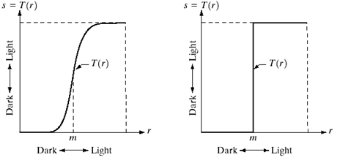

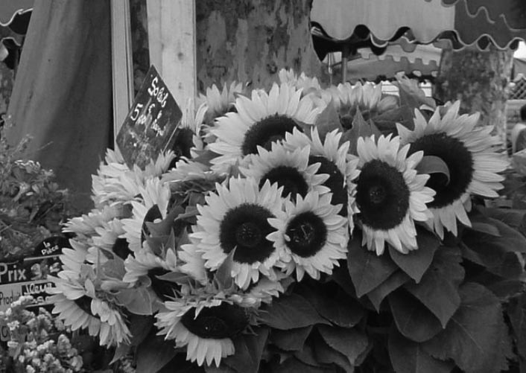


Intensity Transformation
Intensity
transformation
functions.
(a) Contrast
stretching
function.
(b) Thresholding
function.
Approaches whose results depend only on the intensity at a point sometimes are called point processing techniques, as opposed to the neighborhood processing techniques

Slide 8
Image Enhancement
Enhancement is the process of manipulating an image so that the result is more suitable than the original for a specific application
Because we deal with digital quantities, values of an intensity transformation function typically are stored in a table, and the mappings from r to s are implemented via table lookups.
For an 8-bit image, a lookup table containing the values of T will have 256 entries.
Three basic types of functions used in IP: linear (negative and iden- tity transformations), logarithmic (log and inverse-log transform-ations), and power-law (nth power and nth root transformations).

Slide 9
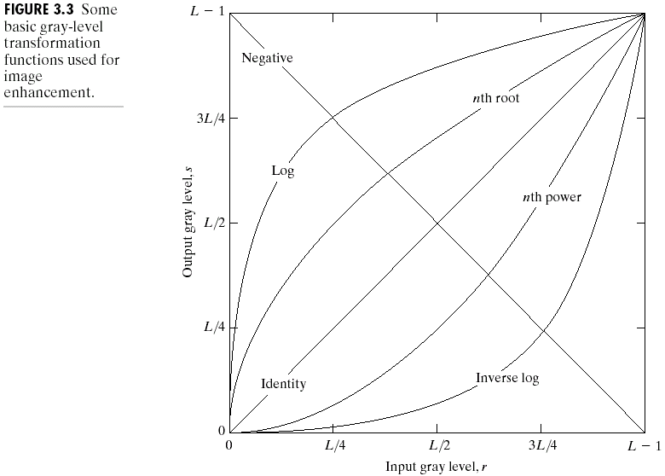
Some Basic Gray Level Transformations

Slide 10
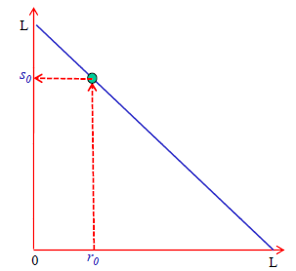
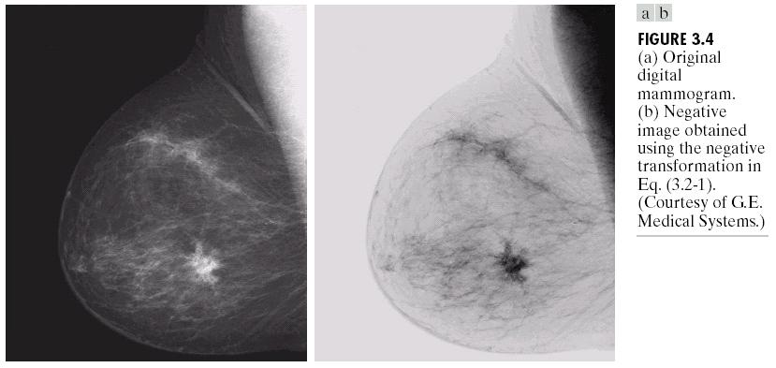
Image Negatives
Let the range of gray level be [0, L-1], then

Slide 11
Log Transformations
where c : constant
This transformation maps a narrow range of low intensity values in the input into a wider range of output levels.
Higher values of input levels are mapped to a narrower range in the output.
Expand the values of dark pixels in an image, while compressing the higher-level values
The log function has the important characteristic that it compresses the dynamic range of pixel values.

Slide 12
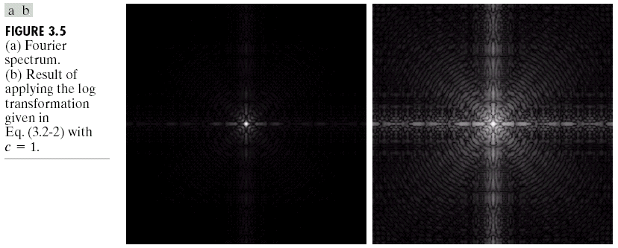
Fourier Transform 0 to 1.5 x 10⁶ values are scaled linearly for display in an 8-bit system,aa1
range of values of the result becomes 0 to 6.2. result of scaling the intensity range linearly to theinterval [0, 255] and showing the spectrum in the same 8-bit display

Slide 13
Gamma Correction
The response of many devices used for image capture, printing, and display obey a power law. The exponent in a power-law equation is referred to as gamma.
The process used to correct these power-law response phenomena is called gamma correction or gamma encoding

Slide 14
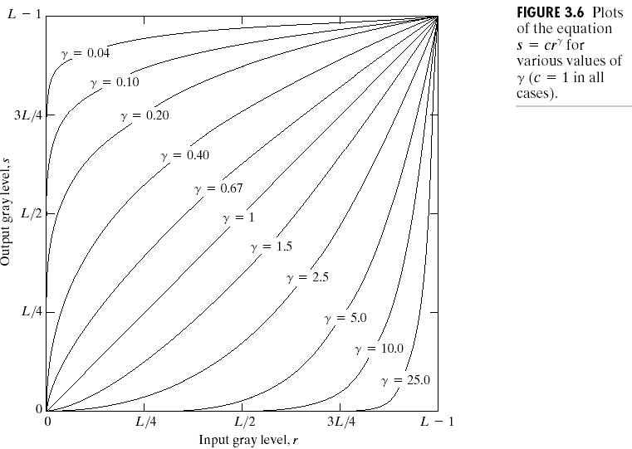
Power-Law Transformation
where c, : positive constants

Slide 15
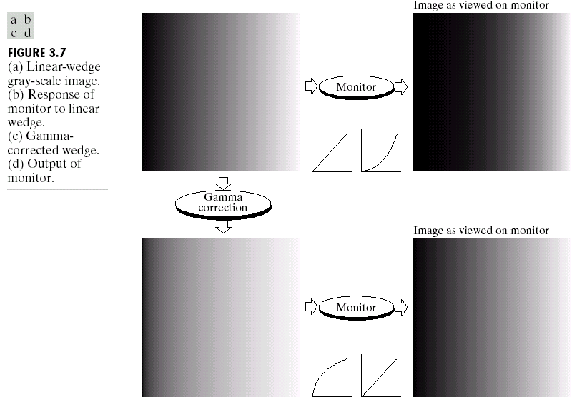
Power-Law Transformation
Example 1: Gamma Correction

Slide 16
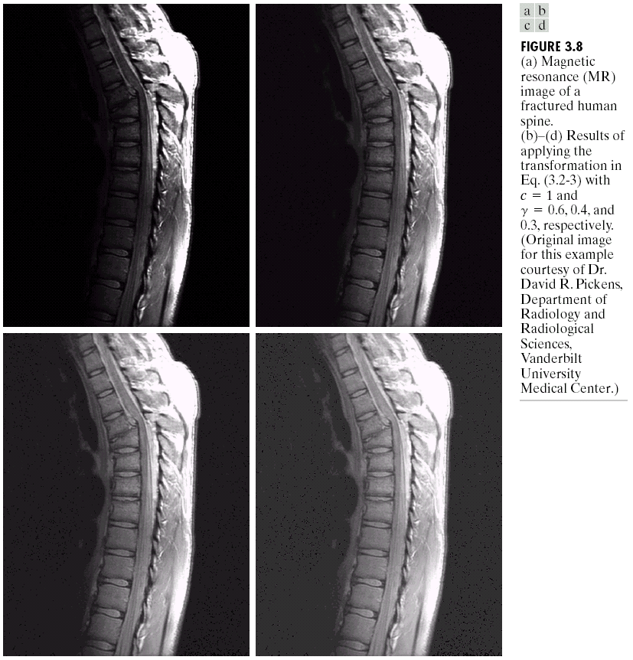
Power-Law Transformation
Example 2: Gamma Correction

Slide 17
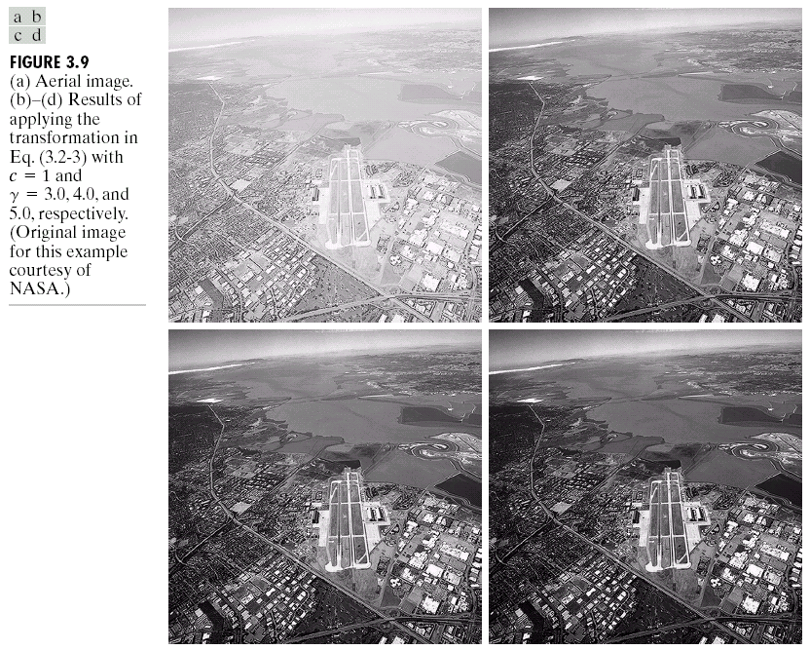
Power-Law Transformation
Example 3: Gamma Correction

Slide 18
Piecewise-Linear Transformation Functions
These functions, as the name suggests, are not entirely linear in nature.
However, they are linear between certain x-intervals.
One of the most commonly used piecewise-linear transformation functions is contrast stretching.

Slide 19
Piecewise-Linear Transformation Functions- Contrast Stretching
Low-contrast images - result from poor illumination, lack of dynamic range in the imaging sensor, or wrong setting of a lens aperture during image acquisition.
Contrast stretching expands the range of intensity levels in an image so that it spans the ideal full intensity range of the recording medium or display device.

Slide 20
Piecewise-Linear Transformation Functions- Contrast Stretching
A typical transformation used for contrast stretching is shown below.
The locations of points (r1 , s1 ) and (r2 , s2 )

Slide 21
Piecewise-Linear Transformation Functions- Contrast Stretching
If (r1 = s1 ) and (r2 = s2 ), the transformation is a linear function that produces no changes in intensity.
If r1= r2 , s1 = 0, and s2=L-1 the transformation becomes a thresholding function that creates a binary image.
Intermediate values of (r1 , s1 ) and (r2 , s2 ) produce various degrees of spread in the intensity levels of the output image, thus affecting its contrast.

Slide 22
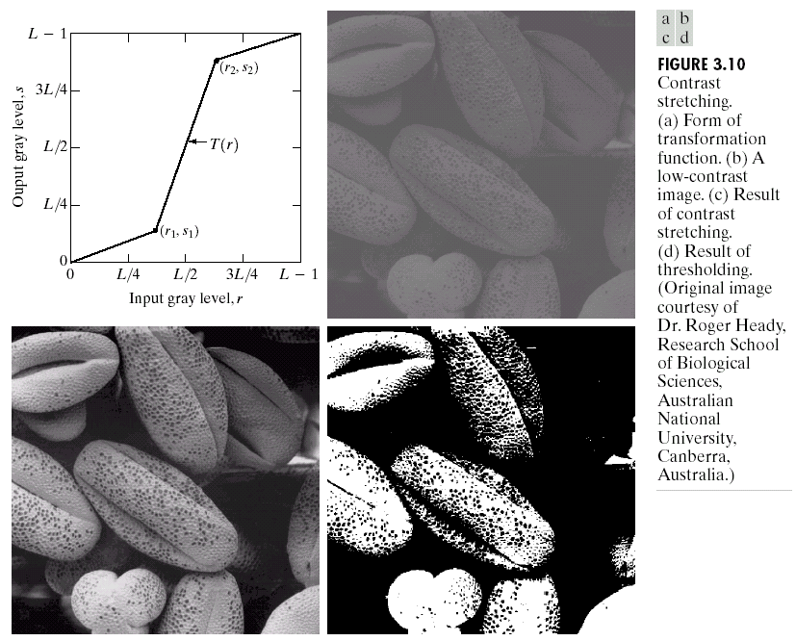
Piecewise-Linear Transformation Functions
Case 1: Contrast Stretching
( r1, s1) =( rmin , 0 ) and (r2 ,s2 ) =(rmax , L-1), where rmin and rmax denote the minimum and maximum intensity levels in the input image,
the result of using the thresholding
function, with (r , s ) (m, ) 1 1 = 0 and (r , s ) (m, L ), 2 2 = − 1 where m is the mean
intensity level in the image.

Slide 23
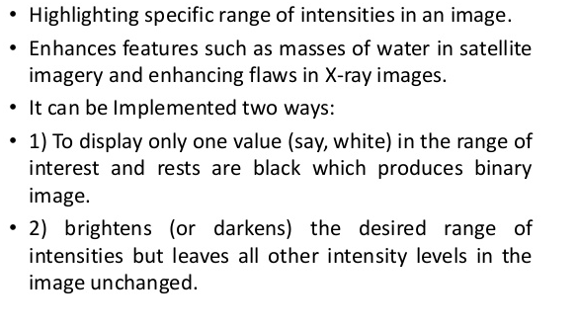
Piecewise-Linear Transformation Functions
Case 2:Intensity-level Slicing

Slide 24
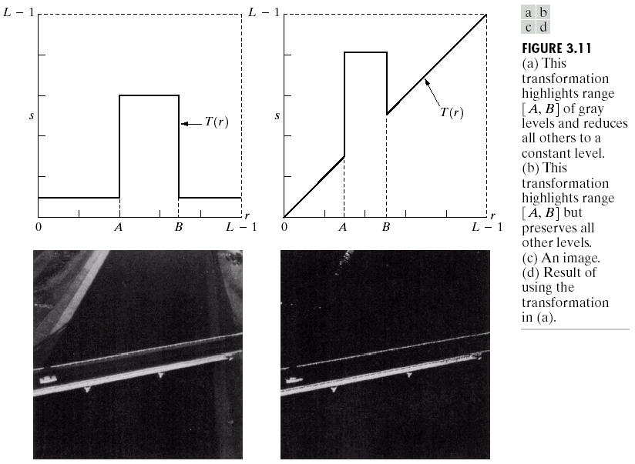
Piecewise-Linear Transformation Functions
Case 2:Intensity-level Slicing
An image
Result of using the transformation in (a)

Slide 26
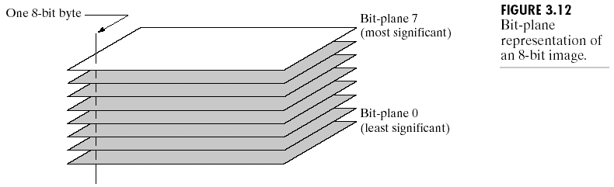
Piecewise-Linear Transformation Functions
Case 3:Bit-plane Slicing
Bit-plane slicing:
Instead of highlighting the intensity level ranges, we could highlight the contribution made to the total image appearance by specific bits.
Each pixel in an image represented by 8 bits.
Image is composed of eight 1-bit planes, ranging from bit-plane 0 for the least significant bit to bit plane 7 for the most significant bit.

Slide 27
Piecewise-Linear Transformation Functions
Bit-plane Slicing
The original image has a gray border whose intensity is 194.
The first two, contain a significant amount of the visually-significant data.
The lower-order planes contribute to more subtle intensity details in the image.

Slide 28
The binary image for the 8th bit plane of an 8-bit image can be obtained by thresholding the input image with a transformation function that maps to 0 intensity values between 0 and 127, and maps to 1 values between 128 and 255.
The binary image for the 7th bit plane of an 8-bit image can be obtained by using the input image with a transformation function that maps to 1, the intensity values between 64 and 127 as well as the intensity vales above 127 where the 7th bit is 1, and maps to 0 values and values between 0-63.
Similarly for 3rd bit plane – intensity values whose binary equivalent has a 1 at its 3rd bit from right between maps to 1 rest to 0
Similarly for 1st bit plane – intensity values which are odd maps to 1 rest to 0

Slide 29
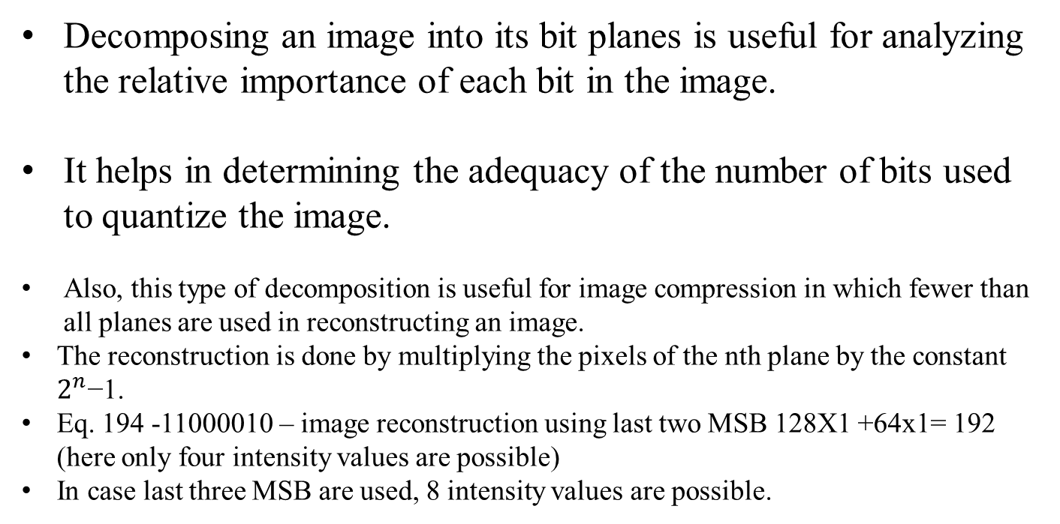
Piecewise-Linear Transformation Functions
Bit-plane Slicing
Decomposing an image into its bit planes is useful for analyzing the relative importance of each bit in the image.
It helps in determining the adequacy of the number of bits used to quantize the image.
Also, this type of decomposition is useful for image compression in which fewer than all planes are used in reconstructing an image.
The reconstruction is done by multiplying the pixels of the nth plane by the constant $2^{n}$−1.
Eq. 194 -11000010 – image reconstruction using last two MSB 128X1 +64x1= 192 (here only four intensity values are possible)
In case last three MSB are used, 8 intensity values are possible.

Slide 30
Piecewise-Linear Transformation Functions
Bit-plane Slicing
Although the main features of the original image were restored, the reconstructed image appears flat, especially in the background. This is not surprising, because two planes can produce only four distinct intensity levels.

Slide 32
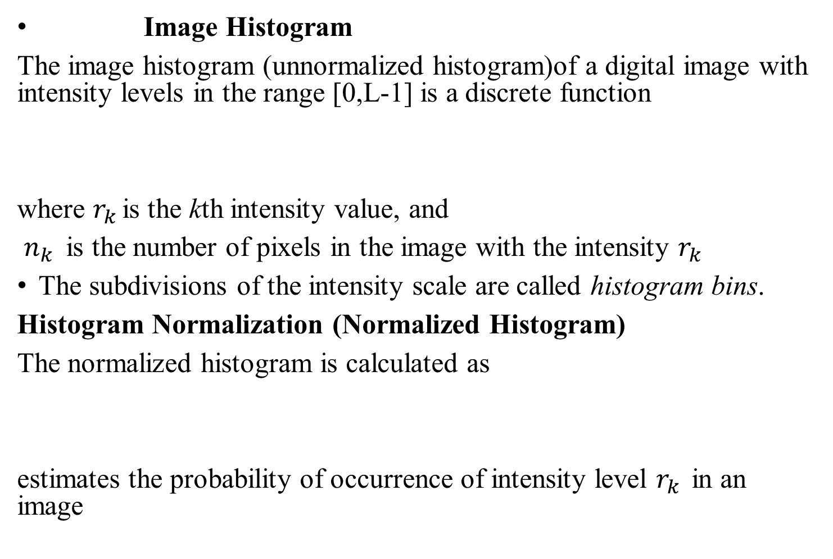
Histogram
Image Histogram
The image histogram (unnormalized histogram)of a digital image with intensity levels in the range [0,L-1] is a discrete function
where $r_{k }$is the kth intensity value, and
$n_{k }$ is the number of pixels in the image with the intensity $r_{k }$
The subdivisions of the intensity scale are called histogram bins.
Histogram Normalization (Normalized Histogram)
The normalized histogram is calculated as
estimates the probability of occurrence of intensity level $r_{k }$in an image

Slide 33

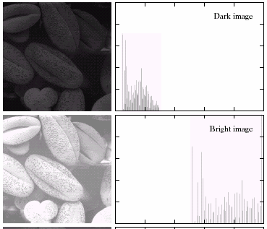
Histogram Processing
Histogram shape is related to image appearance.

Slide 34
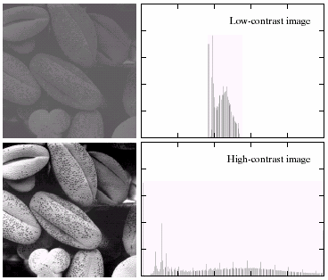
Histogram Processing

Slide 35
Histogram Processing
An image whose pixels tend to occupy the entire range of possible intensity levels and, in addition, tend to be distributed uniformly, will have an appearance of high contrast and will exhibit a large variety of gray tones

Slide 36



Histogram Equalization
Histogram equalization:
To improve the contrast of an image
To transform an image in such a way that the transformed image has a nearly uniform distribution of pixel values
It is not necessary that contrast will always be increase in this.
There may be some cases were histogram equalization can be worse. In that cases the contrast is decreased.
Transformation:
Assume r to be in the interval [0,L-1], with r = 0 representing black and r = L-1 representing white
The transformation function satisfies the following conditions:
a) T(r) is single-valued and monotonically increasing in the interval
b)
$$s=T\left(r\right) 0≤r≤L−1$$
$$0≤r≤L−1$$
$$0≤T\left(r\right)≤L−1 \text{for} 0≤r≤L−1$$

Slide 37

Histogram Equalization
Inverse transformation
in which case we change condition (a) to (aa):
(aa) T(r) is a strictly monotonic increasing function in the interval
The condition in (a) that T(r) be monotonically increasing guarantees that output intensity values will never be less than corresponding input values, thus preventing artifacts created by reversals of intensity.
Condition (b) guarantees that the range of output intensities is the same as the input.
Finally, condition (aa) guarantees that the mappings from s back to r will be one-to-one, thus preventing ambiguities
$$0≤r≤L−1$$

Slide 38
Histogram Equalization
For example:

Slide 39
Histogram Equalization
In discrete version:
The probability of occurrence of gray level r_{k} in an image is
n : the total number of pixels in the image
n_{k} : the number of pixels that have gray level r_{k}
L : the total number of possible gray levels in the image
The transformation function is
Thus, an output image is obtained by mapping each pixel with level r_{k} in the input image into a corresponding pixel with level s_{k}.

Slide 40
Histogram Equalization
Suppose that a 3-bit image (L = 8) of size 64 ξ 64 pixels (MN = 4096) has the intensity distribution in Table 3.1, where the intensity levels are integers in the range [0, L − 1] = [0, 7]. Find the values of the histogram equalization transformation function

Slide 41
Histogram Equalization

Slide 42
Histogram Equalization

Slide 43
Histogram Equalization

Slide 44
Histogram Equalization

Slide 45
Histogram Equalization

